Slide 1
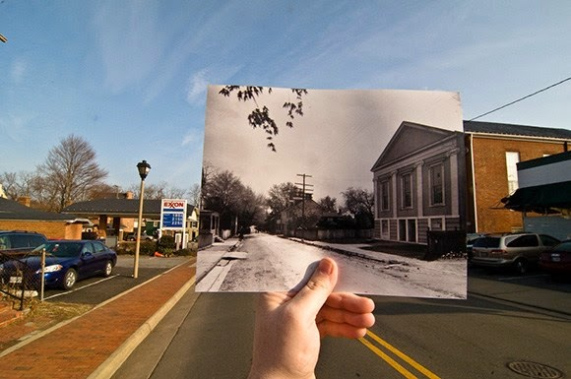
Where You’ve Been
You have written (or are almost finished writing) a personal essay about the impact of Digital Mobile Computing Technology (DMCT) based on your experience.
You have considered areas of interest/issues that you would like to learn more about (such as cyberbullying, privacy/security, navigation/maps/travel, education, etc.)

Slide 2
Let’s Go Site-Seeing! It’s Time to Do Some Research!
Where To Go / About TEL
What You’ll See
Variety is key! (Primary, secondary, types of sources)
You can afford to be picky.
Evaluating Sources
CRAP Test
Wikipedia: To Cite or Not to Cite?
Domain Names

Slide 3
Internet Domain Names
.com – commercial site (business website)
.edu — A school, university, museum, or educational
.gov — A U.S. government site.
.mil — A U.S. military site.
.museum — A museum.
.net — A network service provider; Internet administrative site.
.org — An organization, often non-profit. These sites can provide accurate information, but usually have bias.
.pro — A professional’s site.
~ (tilde) or % — A personal site that varies in its credibility

